Slide 1

AUTOMATING AND
ENHANCING THE MEETING
EXPERIENCE WITH
GOOGLE CLOUD
By Team: Cloud Warriors

Slide 2



PROPOSED SOLUTIONS
Real time speech transcription
This feature will transcribe the conversation in the meeting into text.
The solution would convert speech to text in real time.
Additionally, this will also enable multiple speakers to recognize who is speaking.
This generated transcript can be referred to anytime later.
Automatic Reminder
Meeting transcript would be scanned to let participants know if items in agenda were discussed or not.
Agenda is given in the meeting invite.
An agenda goes green if it is discussed or gray at the end of the meeting if it is not with the help of the transcript.
Meeting Assistant
Minutes and important notes that are to be highlighted can be done with the help of Meeting Assistant – preloaded and made to listen for key phrases.
If the user says “Assistant, Note this” – the text will be marked important and would go into the minutes.
If the user says “Assistant, note action point for X ” – then the Assistant will note the action plan that is mentioned after the key phrase against X.

Slide 3


PROPOSED SOLUTIONS
Outlook Integration
Information(meeting description, dates etc.,), agenda and participants about the meeting will be retrieved from the meeting invite in Outlook with the help of an outlook plug-in.
Participant recognition will be used to determine who attended the meeting and who didn’t.
Agenda retrieval will be used together with Automatic Reminder to determine if all the points are covered
Automatically Send Meeting Notes Mail
This will send the whole transcribed text, list of participants who were present, points in the agenda that were covered – after the meeting has ended.
With the help of the Meeting Assistant, minutes/Important notes and action points can be sent too.
This will be sent to all the people present in the invite after the meeting has ended – not just the participants who were present.
Placeholder
Describe

Slide 4
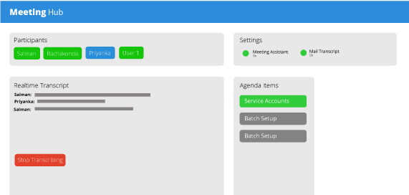
DASHBOARD VIEW
Participant List: identified using voice recognition
Transcript: English language support
Items discussed turn green

Slide 5
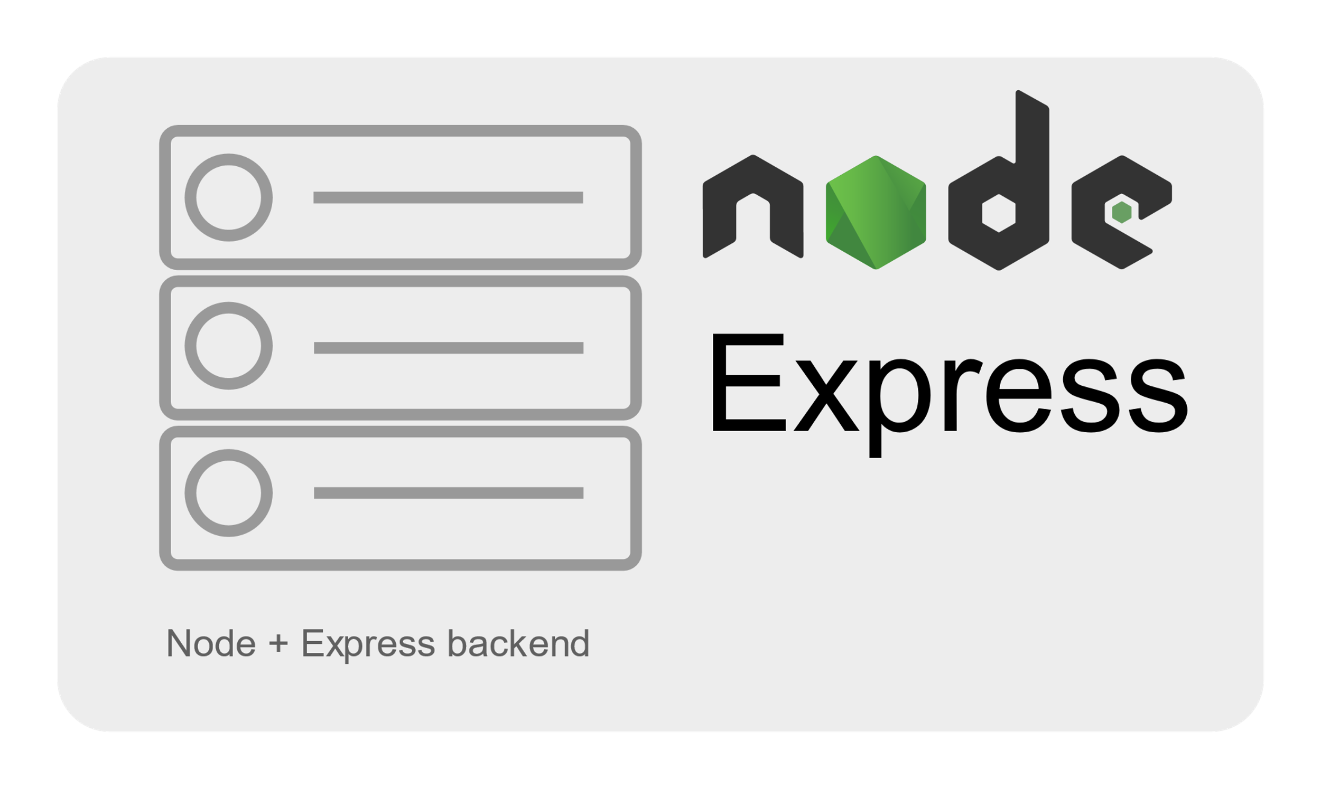

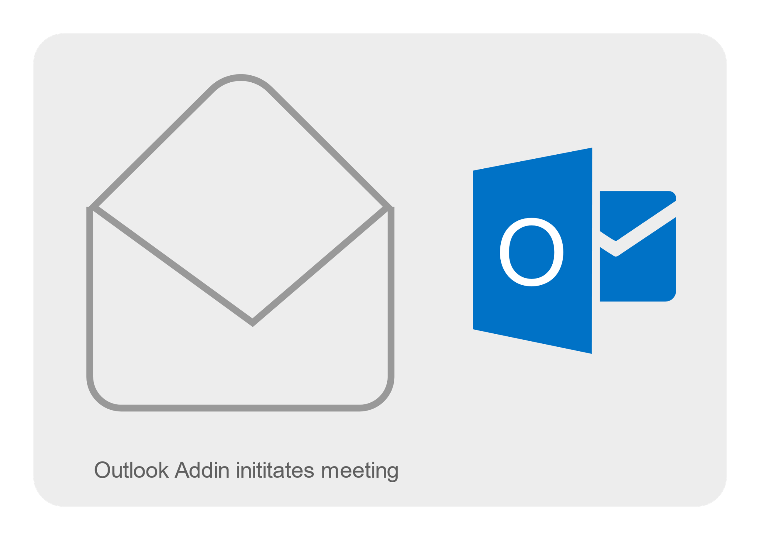

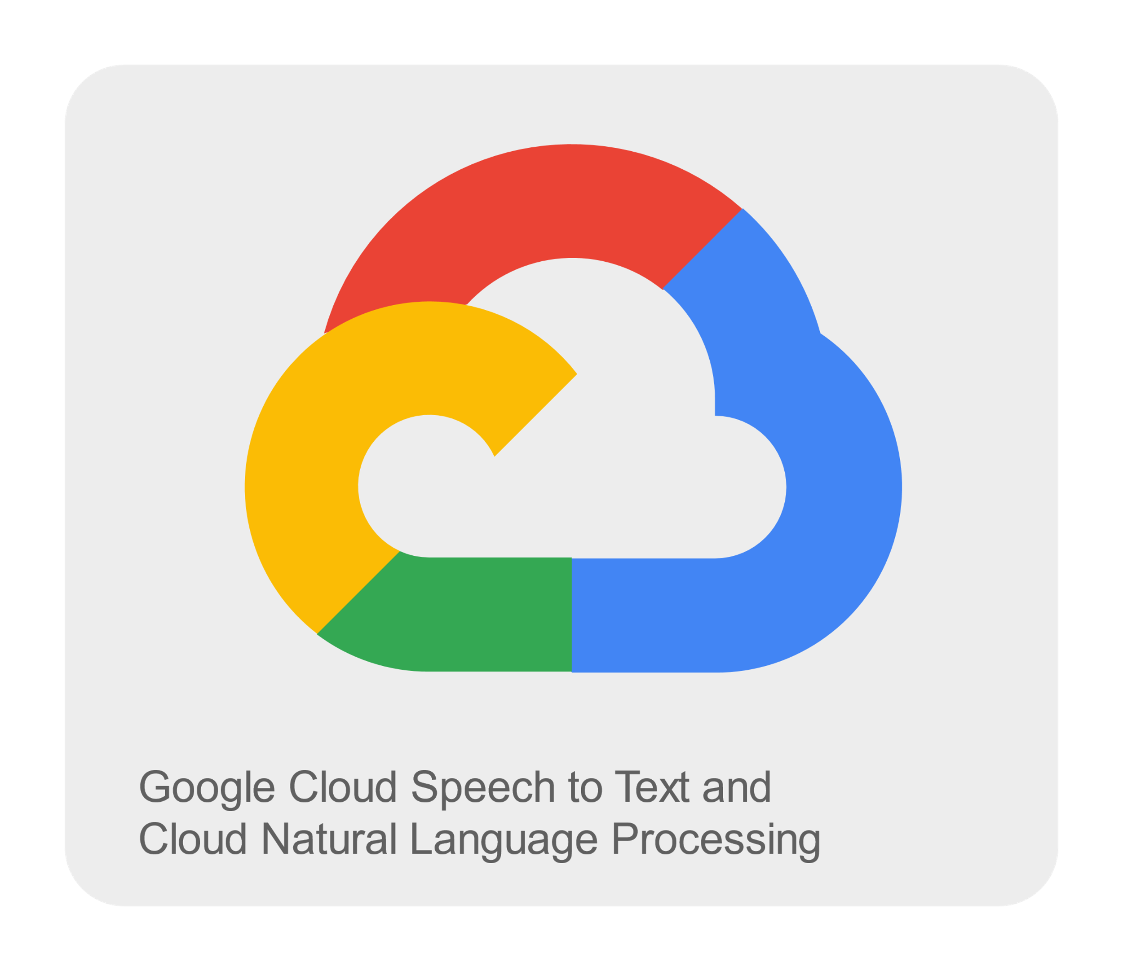
TECH STACK
Voice blob
Text response
Meeting Start
Persistence
Voice Processing

